Slide 1
Data Mining For IOT
Presented by
NEETI JOSHI
15MCEI09

Slide 2
Scope:
Learn the concept of IOT and Data mining and correlation
Implement the IOT data set as per the appropriate data mining algorithm.
Find out the result

Slide 3
Contents
What is IOT?
What is Data Mining?
Whay Data Mining for IOT?
Applications
Implementation
Advantages and Disadvantages
References

Slide 4
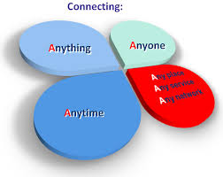

What is IOT?
Informal Definition…

Slide 5
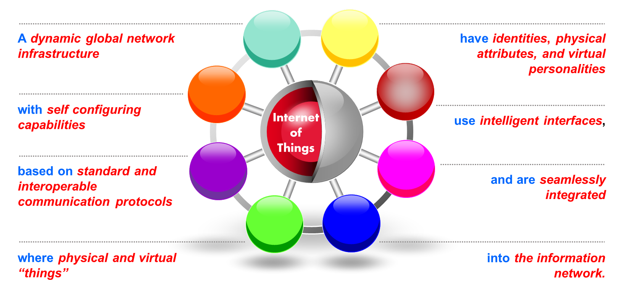
IOT is…

Slide 6

What is Data Mining?
process of analyzing data from different perspectives and summarizing it into useful information

Slide 7
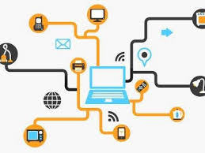

Why Data mining for IOT
Massive Data generate from the IOT. Data mining fetch the useful information from it

Slide 8
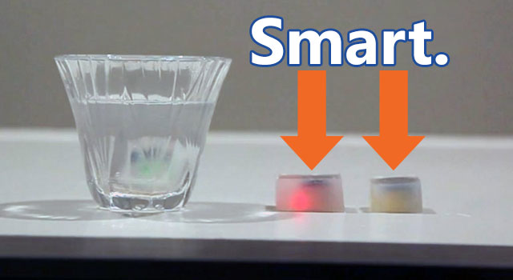
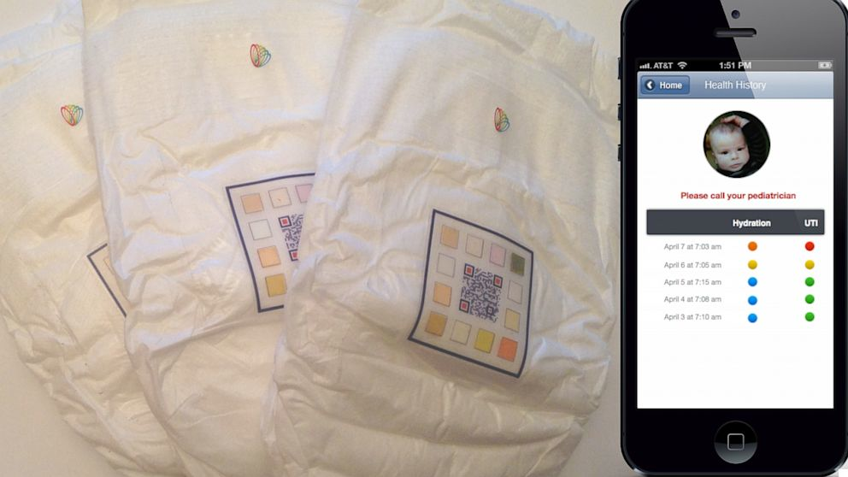
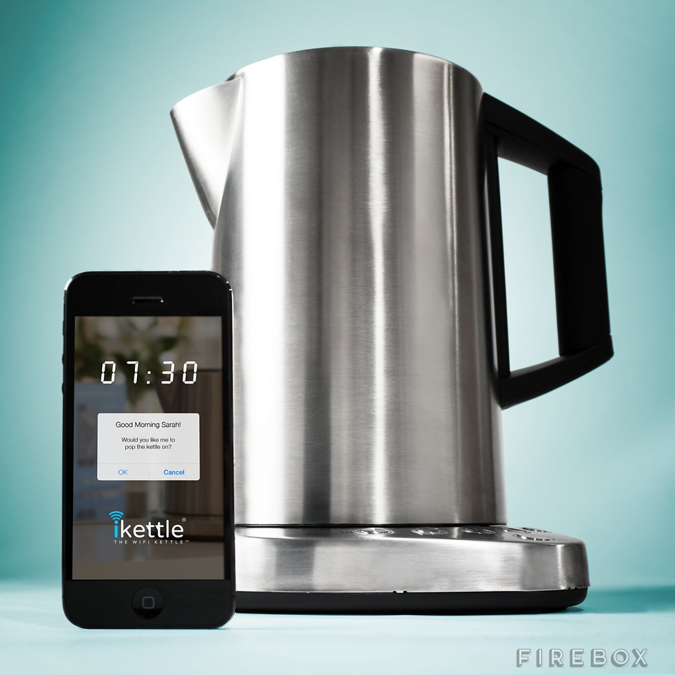
Applications
Smart Ice
Smart Diapers
Firefox ikettle

Slide 9
Data Set: Echocardiogram
Problem Statement:
The record of the patients who are suffered from attacks in past. So find the patients (suffered from attacks) who are alive after the one month

Slide 10
Data Set: Echocardiogram [continue]
Source Information:
Donor: Steven Salzberg (salzberg@cs.jhu.edu)
Collector: Dr. Evlin Kinney
Location: The Reed Institute ,P.O. Box 402603 ,Maimi, FL 33140-0603,
Date Received: 28 February 1989
Attributes: 13
Instances: 59
Missing Values: None ( I have removed missing values)
Using Software: Weka ( version 3.6)

Slide 11
Attributes Information:
Survival -The number of months patient survived (has survived, if patient is still alive).
Still-Alive -A binary variable. 0=dead at end of survival period, 1 means still alive
Age-at-heart-attack -Age in years when heart attack occurred
Pericardial-Effusion-Binary. Pericardial effusion is fluid around the heart. 0=no fluid, 1=fluid
Fractional-Shortening -A measure of contractility around the heart lower numbers are increasingly abnormal
Epss - E-point septal separation, another measure of contractility. Larger numbers are increasingly abnormal.
Lvdd - Left ventricular end-diastolic dimension. This is a measure of the size of the heart at end-diastole. Large hearts tend to be sick hearts.
Wall-motion-score -A measure of how the segments of the left ventricle are moving

Slide 12
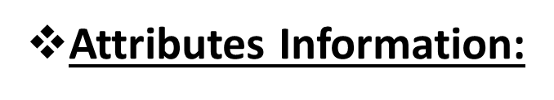
wall-motion-index -Equals wall-motion-score divided by number of segments seen. Usually 12-13 segments are seen in an echocardiogram. Use this variable INSTEAD of the wall motion score.
Mult -A derivate var which can be ignored
Name - the name of the patient (I have replaced them with "name")
Group - meaningless, ignore it
Alive-at-1 -Boolean-valued. Derived from the first two attributes.0 means patient was either dead after 1 year or had been followed for less than 1 year. 1 means patient was alive at 1 year.

Slide 13
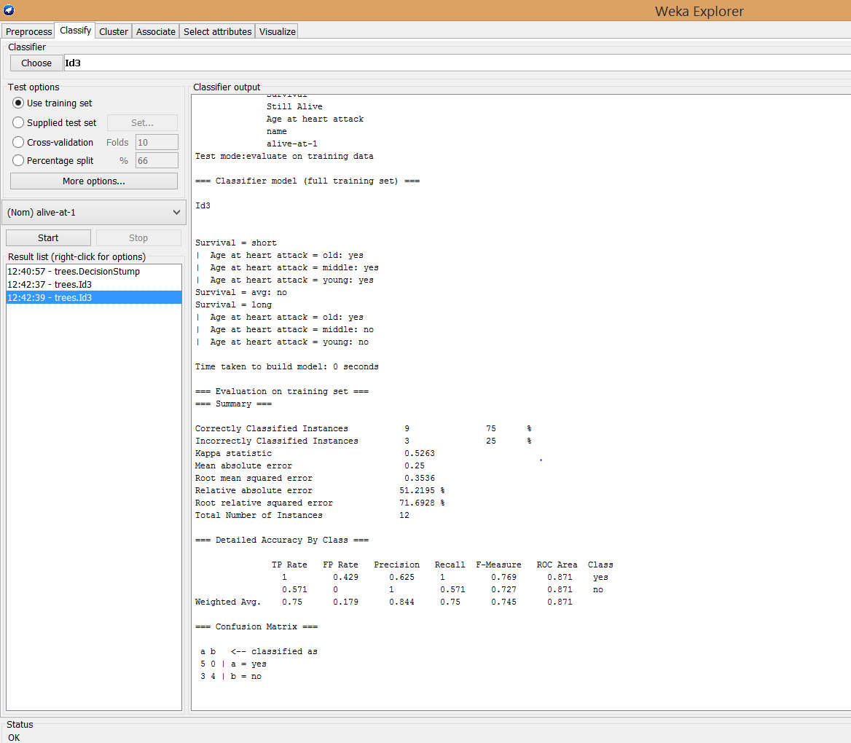
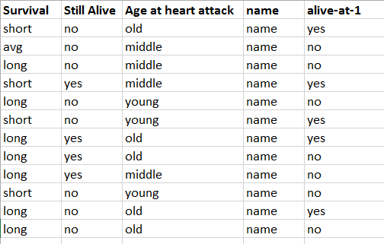
Data sets:
By using Decision Tree(ID3) Algorithm

Slide 14
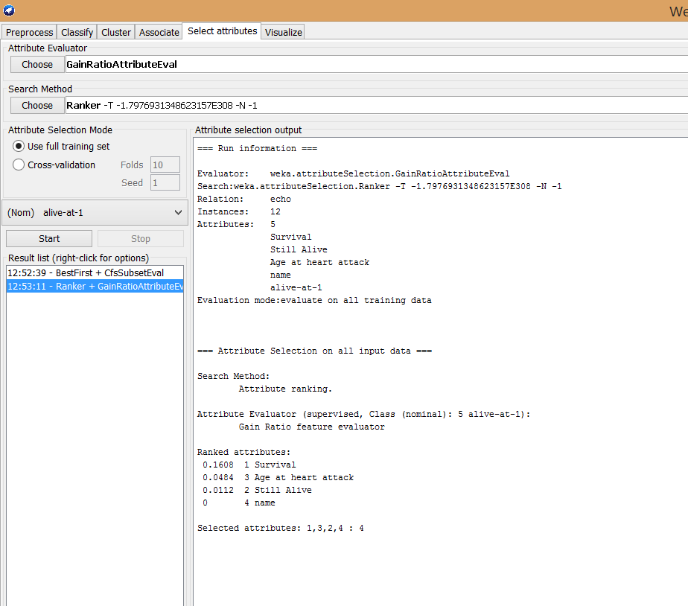
Rank wise Info Gain
Survival= 0.16608
Age at heart attack=0.0484
Still Alive=0.0112
Name=0

Slide 15
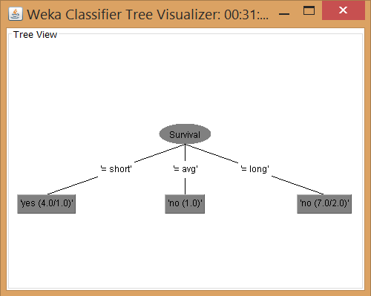
Output:
Decision Tree:

Slide 16
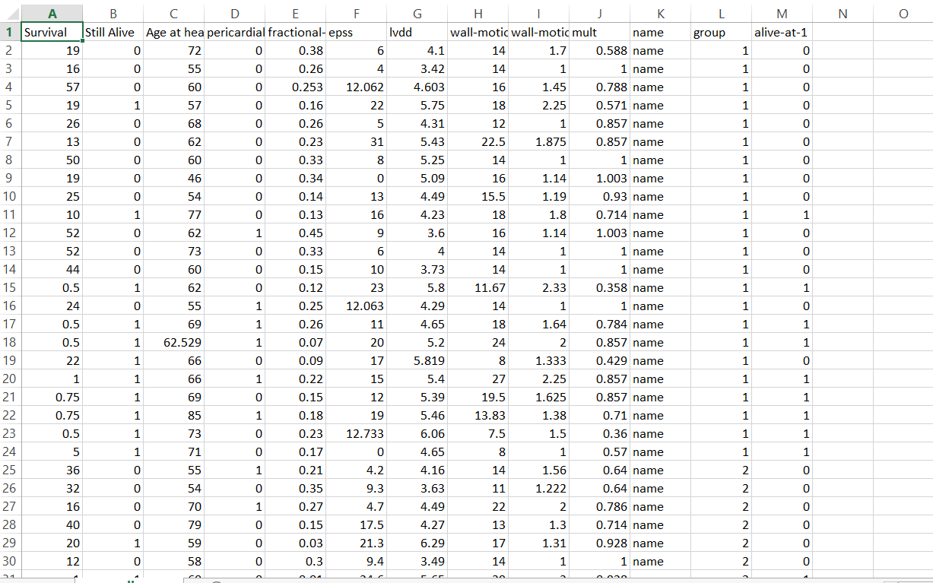
Original Data set:

Slide 17
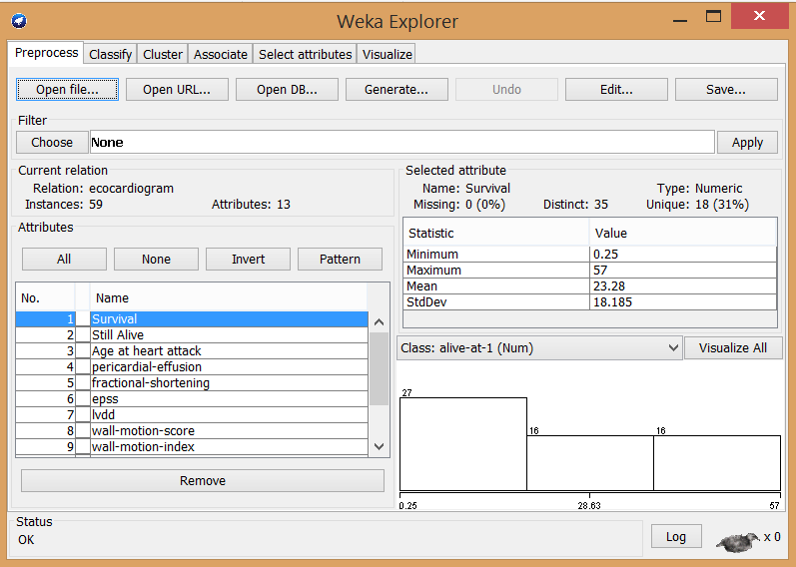
Dataset in Weka

Slide 18
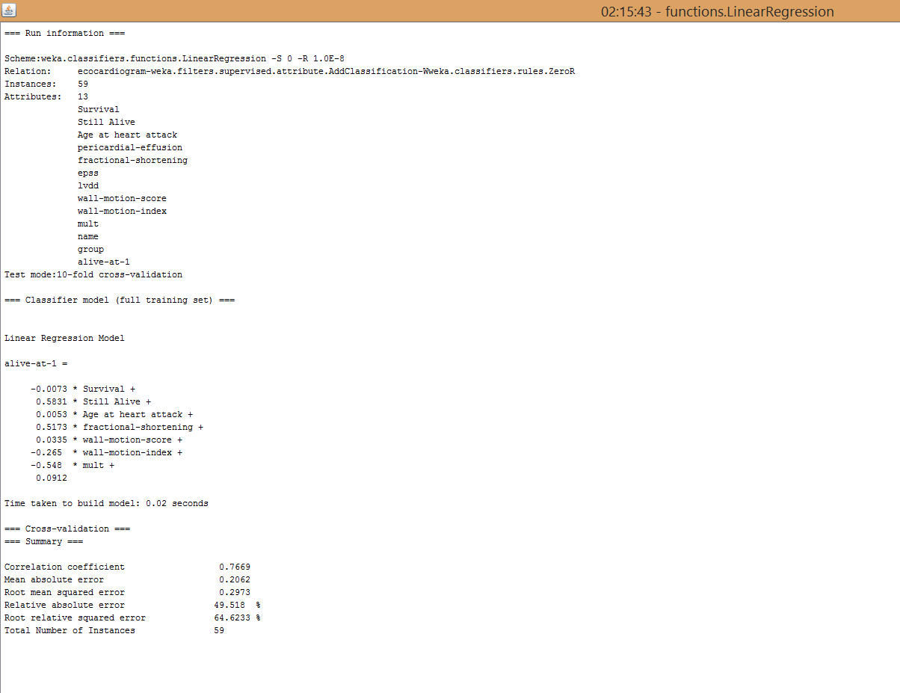
Output:

Slide 19
Advantages:
By providing the knowledge it makes the system smarter.
IOT has large set of data sets but data mining fetch only the useful information at a time.
It provides efficiency in the working of IOT system.
It can replace the human decisions by using its algorithms. Those algorithms are capable to take decisions by its own.
Data mining algorithms can also applied as a security perspectives, data mining algorithms are used to detect the anomaly in the IOT system.

Slide 20
Disadvantages/ Challanges:
Major issue is privacy and security
The information could be misused by applicants
It is difficult to combine the different data mining algorithms when system is going to complex
Big challenge is to select appropriate algorithm.

Slide 21
Conclusion:
On the basis of the research seminar, we have shown the how the IOT applications are used by using data mining algorithm. Also learn the problems and issues related to data mining using the IOT application. I have also taken the small data set and then I have performed data mining on large dataset. The data mining algorithms are varied as per the data sets. Whether it should belongs to classification, clustering or what. So the selection of appropriate algorithm is necessary.

Slide 22
Future Scope:
Recently I have done the implementation on the off-line data set of echocardiogram as an IOT application by considering the data set is generated by sensors. The future work is to work on stream line data set which are incremental in nature. The result and prediction would be differ at each instance in this case. So future work is to implementing the streamline dataset using data mining algorithm.

Slide 23
References
K. Ashton, “That ‘Internet of Things’ Thing,” 2009, RFID Journal, Available at http://www.rfidjournal.com/article/print/4986.
Auto-ID Labs, Massachusetts Institute of Technology, 2012, available at http://www.autoidlabs.org/.
L. Atzori, A. Iera, and G. Morabito, “The internet of things: A survey,” Computer Networks, vol. 54, no. 15, pp. 2787–2805, 2010.
D. Miorandi, S. Sicari, F. De Pellegrini, and I. Chlamtac, “Internet of things: Vision, applications and research challenges,” Ad Hoc Networks, vol. 10, no. 7, pp. 1497–1516, 2012.

Slide 24
Thank You

